Slide 1
Module 1: Machine Learning Basics in Materials Science
Ben Afflerbach
5/11/2020
Dane Morgan
9/6/22
All ML slides updated from https://nanohub.org/resources/intromllab/about

Slide 2
Overview
What is Machine Learning?
Machine learning is a tool that finds patterns in large datasets that might be hard to discover otherwise
How can we use it for Materials Science?
It can be included in existing materials science workflows to accelerate research, materials design, and materials discovery
Identify Materials Properties
Train Model of Properties
Predict Properties For New Chemical Compositions
Synthesize and Verify Predictions
Regression
Example:
Notes:
- There are two key takeaway messages that we’ll cover in this slide deck. We’ll highlight them now and then again at the end.
- Bottom diagram is our basic overview of a simple materials design workflow

Slide 3
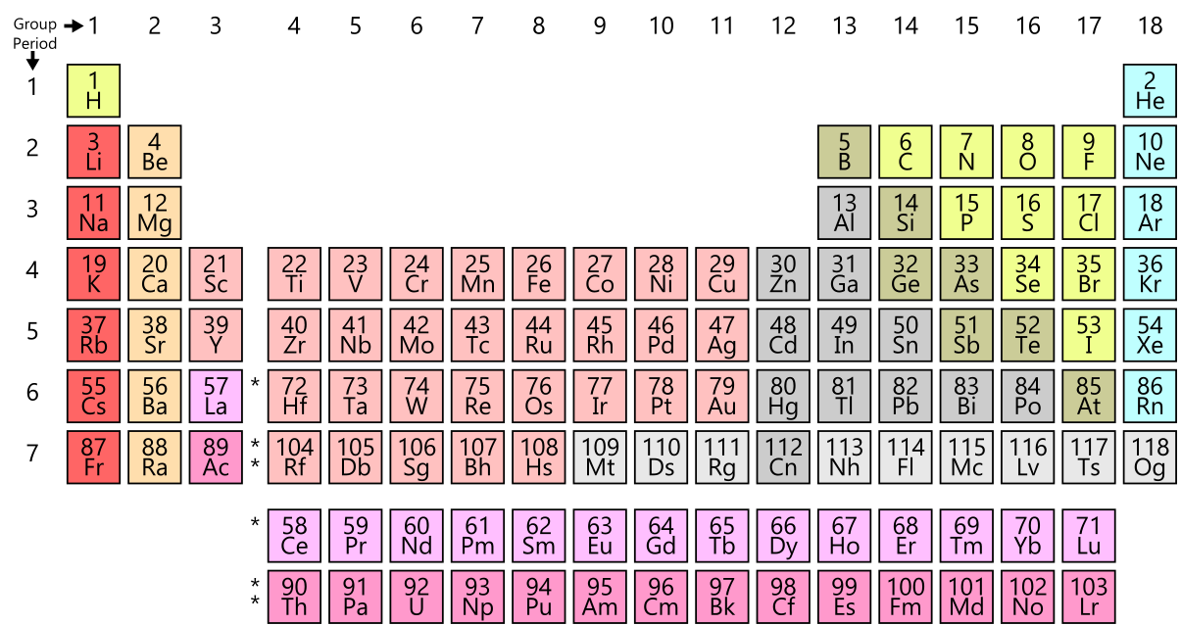
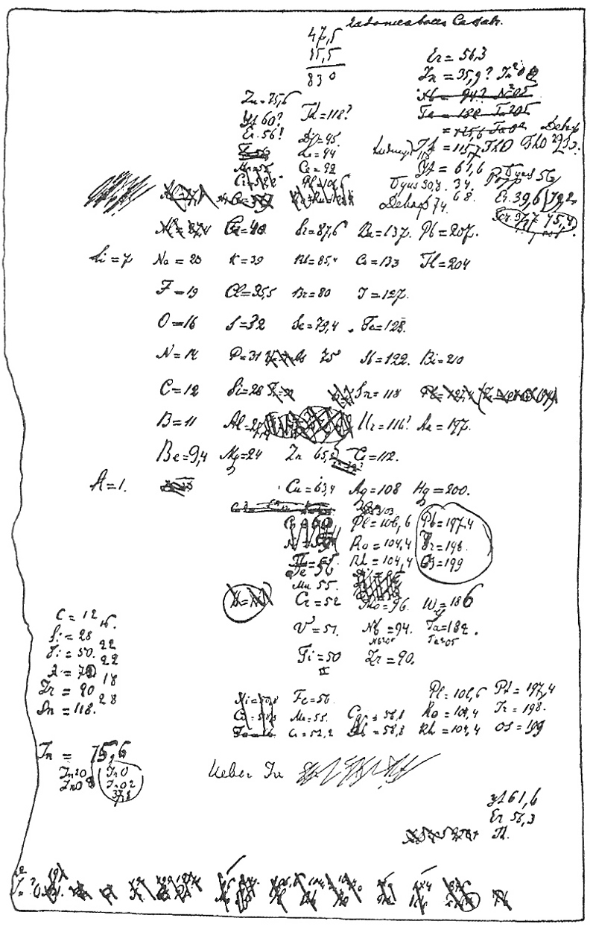
Machine Learning in MS&E
Using existing property data to make predictions about new property data, e.g., to guide future experiments or increase database size.
Replacing physical models with ”correlative” data-centric models (e.g. machine learned catalytic activity vs. composition/processing).
Interpreting and extracting data from images and text.
Data-centric MS&E is not new, but transformed by new data, computation, and algorithms
Draft of table from D. Mendelejeff, Zeitschrift für Chemie 12, 405-406 (1869) (Work from Dmitrii Mendeleev)

Slide 4
Machine Learning in MS&E
Using existing property data to make predictions about new property data, e.g., to guide future experiments or increase database size.
Replacing physical models with ”correlative” data-centric models (e.g. machine learned catalytic activity vs. composition/processing).
Interpreting and extracting data from images and text.
Rapid growth in machine learning related materials research
Adapted from D. Morgan and R. Jacobs, Ann Rev Mat Res ‘20

Slide 5


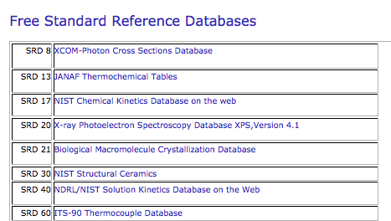
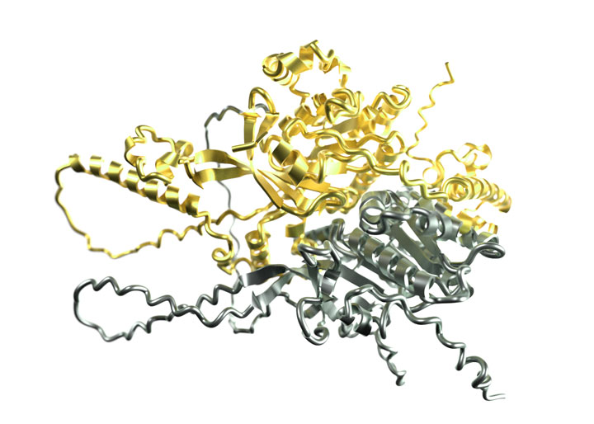
What Happened That We Suddenly Need A Class on This?
Transformative Tools
Massive Data
New Hardware
Incredible opportunity for new science
Example: Solved the protein folding problem (all structures approximately known, with interactions coming). Science 2021 Breakthrough of the Year!
Notes:
DALLE pic, NIST databases, some GPU or neuromorphic chip.

Slide 6
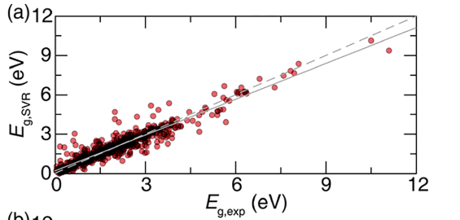
An Application: Predict a Materials Property
Bandgaps in Semiconductors
ML Predictions
Known Values
Machine learning prediction here is obtained from only properties of the elements in the material!
Y. Zhuo, et al. The Journal of Physical Chemistry Letters 2018 9 (7), 1668-1673. DOI: 10.1021/acs.jpclett.8b00124
Notes:
Before jumping in we’ll show one example that highlights some of the power of machine learning
Machine Learning can predict materials properties much faster than traditional techniques (experiments, computational simulations)
This example shows predictions on the Y-axis that were obtained from only compositional information of the materials!
Notice how close the majority of data points are to a “perfect prediction” which would fall on the dashed line

Slide 7
A Basic Materials Design Workflow
Identify Materials Properties
Train Model of Properties
Predict Properties For New Chemical Compositions
Synthesize and Verify Predictions
Training Details
Generate Training Data
Data Cleaning
Feature Generation and Engineering
Model Assessment
Model Optimization
Predictions
Notes:
Throughout these materials we’ll be calling back to our over-arching example of performing materials design
Point out how a machine learning model in the second box could basically be substituted with any other modeling technique as well.
We’ll talk more about training details in the next slide decks
For now the key idea is that we’ll be focusing on this idea of building models to predict properties
Worth pointing out that this isn’t everything that machine learning can do! We’re just choosing a specific objective to focus on!

Slide 8
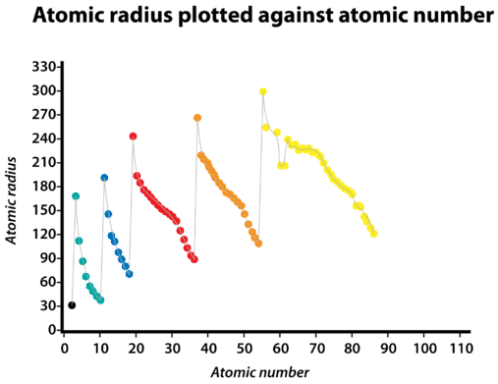
Machine Learning is Pattern Matching
https://chem.libretexts.org/Bookshelves/Introductory_Chemistry (accessed May, 2020)
Notes:
Machine learning makes predictions by identifying patterns within data that it has been trained on
As an example in materials science students probably already have an intuition about various trends within the periodic table.
For example if we view this representation of atomic radius vs atomic number we can see a general trend of increasing radius with atomic number, but also a sawtooth pattern as well
In this example the pattern can be seen by simply plotting against the atomic number, but in general patterns tend to be much more complex and may require many variables that our brains can’t visualize as easily.
In order to find these patterns a model needs large amounts of data to train on, ideally thousands of data points.

Slide 9
Machine Learning Algorithms
ML algorithms are at the heart of ML applications in MSE, although they are often not the most time-consuming part of developing a useful MSE tool. That is generally related to getting and cleaning data, and perhaps deploying and maintaining a model.
Here we describe some basic aspects of the algorithms and how they learn.

Slide 10
Key Distinction in ML
Supervised Learning
Unsupervised Learning
Labels (Output Data)
Input Data X₂
Input Data X
Input Data X₁
Find a Function that represents the data (Labels)
Find Structure in the data
(No Labels)
Notes:
Now we’re going to talk about a bit more specifics of machine learning.
When talking about machine learning there are a few major different types, and depending on which one we choose we would have to approach things very differently
For the rest of our discussion we’ll be talking about supervised learning, where we have output data or “labels” for everything
Therefore the goal of machine learning is to find some function that predicts these labels from the inputs

Slide 11
Two Major Types of ML Goals
Regression
Classification
Bandgap
Insulator
Conductor
Fatigue Strength
Brittle Failure
Ductile Failure
Transformation Temp.
Is Shape Memory Alloy
Not Shape Memory Alloy
Notes:
The second key distinction is in how our outputs for supervised learning are structured
Regression gives continuous outputs, while classification gives distinct predictions of a class
For our examples we’ll be assuming regression models going forward

Slide 12
Model Types
Linear Models
Kernel Ridge
Support Vector Machines
Nearest Neighbors
Gaussian Processes
Decision Trees
Random Forests
Neural Networks
…
These can be very technical so we will not spend time on any detailed methods at this point.
Most can be trained with a simple function call so only qualitative understanding is necessary for using them.
For a more complete list of models
https://scikit-learn.org/stable/supervised_learning.html
Notes:
There are many different model types, some of which you may have heard of
They all are fundamentally trying to do the same thing, finding that function to map inputs to outputs and identify patterns
However, they all do that is drastically different ways
We’re going to again limit ourselves to just one choice, in the interest of time. Decision trees are easy to get a grasp of, and require little math background to understand

Slide 13
Two Major Types of ML Methods
Traditional Learning
Deep Learning
Previous listed models are all in this category.
Modest numbers of adjustable parameters (10-1000).
Parameters constrained relatively uniquely by data. So each fit starts from scratch.
Input are features specified by human guidance to make tractable (e.g., Fourier expansion of intensities in image).
Generally faster, easier to use and make accurate.
A special category of neural networks with many layers.
Can have 10^5-10^11 parameters (and growing).
Parameters guided by data loosely. So many fits start from previous fits (transfer learning) and update only some parameters.
Input can be very basic and complex and feature are learned by the machine (e.g., 512x512 pixel intensities).
Generally slower, harder to use, but more accurate with enough data.
Notes:
The second key distinction is in how our outputs for supervised learning are structured
Regression gives continuous outputs, while classification gives distinct predictions of a class
For our examples we’ll be assuming regression models going forward

Slide 14
Summary
What is Machine Learning?
Machine learning is a tool that finds patterns in large datasets that might be hard to discover otherwise
How can we use it for Materials Science?
It can be included in existing materials science workflows to accelerate research, materials design, and materials discovery
What are some key distinctions in machine learning approaches?
Supervised vs. Unsupervised
Regression vs. Classification
Traditional vs. Deep learning
Notes:
- There are two key takeaway messages that we’ll cover in this slide deck. We’ll highlight them now and then again at the end.
- Bottom diagram is our basic overview of a simple materials design workflow

